Slide 1
Defensive Security Project
by: [Nashwa Elshaarawy, Daniel Kmetz, Betty Ronoh, Josh Welch,]

Slide 2
Table of Contents
This document contains the following resources:
Monitoring Environment
Attack Analysis
Project Summary & Future Mitigations

Slide 3

Monitoring Environment
‹#›

Slide 4
Scenario
Today, you will play the role of an SOC analyst at a small company called Virtual Space Industries (VSI), which designs virtual-reality programs for businesses.
VSI has heard rumors that a competitor, JobeCorp, may launch cyberattacks to disrupt VSI's business.
As an SOC analyst, you are tasked with using Splunk to monitor against potential attacks on your systems and applications.
The VSI products that you have been tasked with monitoring include:
An administrative webpage: https://vsi-corporation.azurewebsites.net/
An Apache web server, which hosts this webpage
A Windows operating system, which runs many of VSI's back-end operations

Slide 5
[“Add-On” App]
‹#›

Slide 6
Website Monitoring
Summary
Monitor websites to detect downtime and performance problems. This app uses a modular input that can be setup easily (in 5 minutes or less).
Features
Uptime Calculation: the Status History dashboard provides information about past failures and calculates the website's uptime percentage
Status Monitoring Dashboard: provides the response time for your monitored websites and provides a historical analysis of the site's responsiveness
Email Outage Alerting: get an emailed alert when your website is down (responds too slowly or is returning an error)
Change History Dashboard: provides information regarding when the monitored pages changed

Slide 7
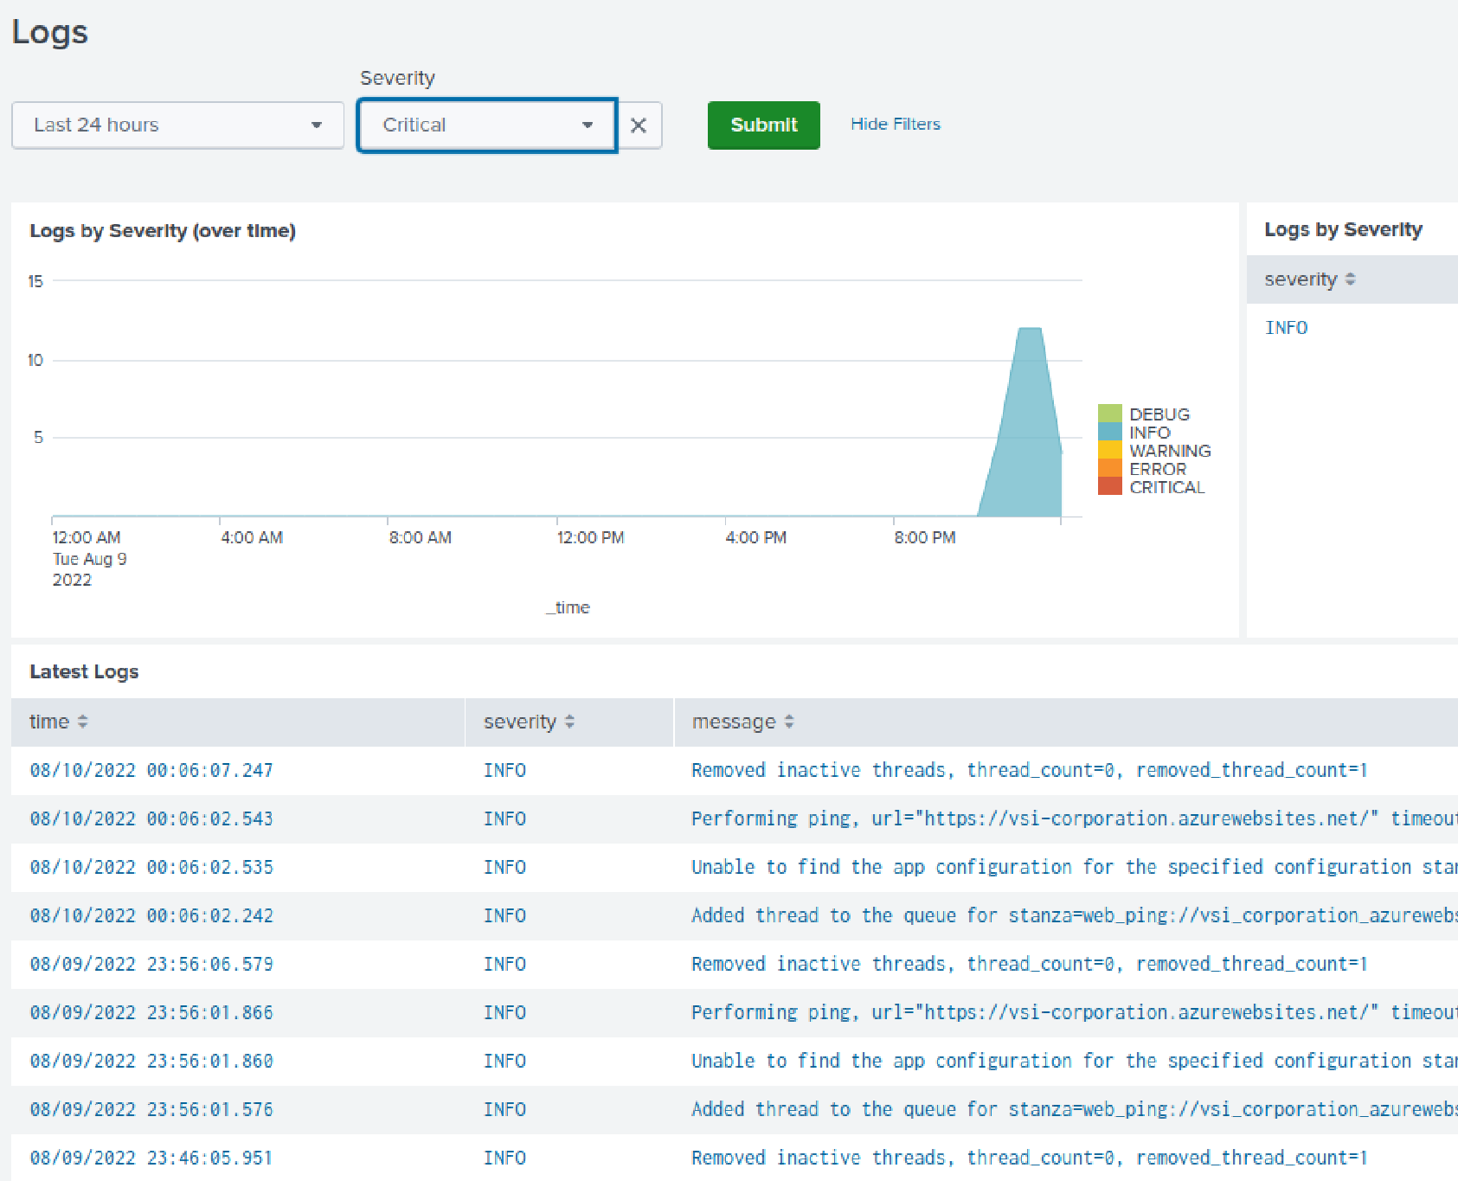
Website Monitoring - Scenario and Benefits
Notes:
Scenario: logs by severity over time.
They are used for data optimization and collection process. To increase efficiency.
Add-ons typically enhance the data from any source and create a rich data set.
Add on is something that helps the Splunk platform in an extended format. These tasks can be worked out with the help of add on available in the Splunk platform
They can consume data from 100s of different sources.
They can automatically select, identify, and tag fields.
Helpful in terms of enriching the data from different information sources

Slide 8
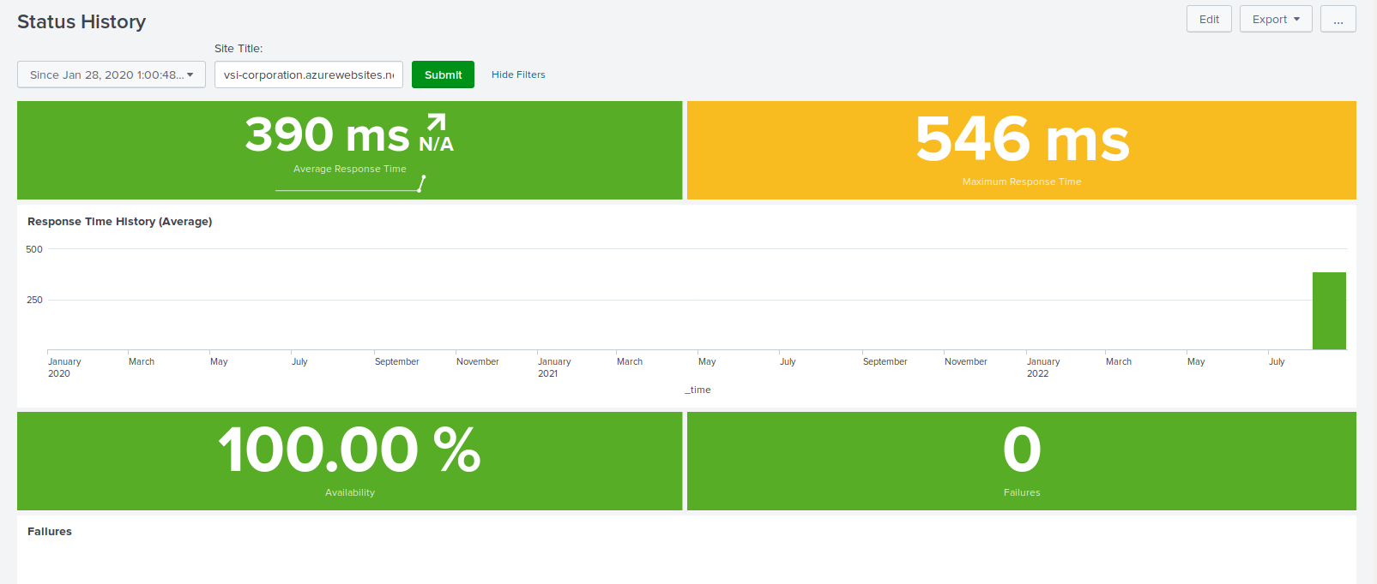
Website Monitoring

Slide 9
Logs Analyzed
Windows Logs
Apache Logs
1
2
This server contains intellectual property of VSI's next-generation virtual-reality programs.
Logs for VSI's main public-facing website, vsi-company.com.

Slide 10
Windows Logs
‹#›

Slide 11
Reports—Windows
Designed the following Reports:
Report Name | Report Description
ID Number Associated with Specific Signature | A report that shows the ID number associated with the specific signature for Windows activity.
Windows Logs Severity | A report to quickly understand the severity levels of the Windows logs being viewed.
Success and Failure - Windows | A report that will show if there is a suspicious level of failed activities on their server.

Slide 12
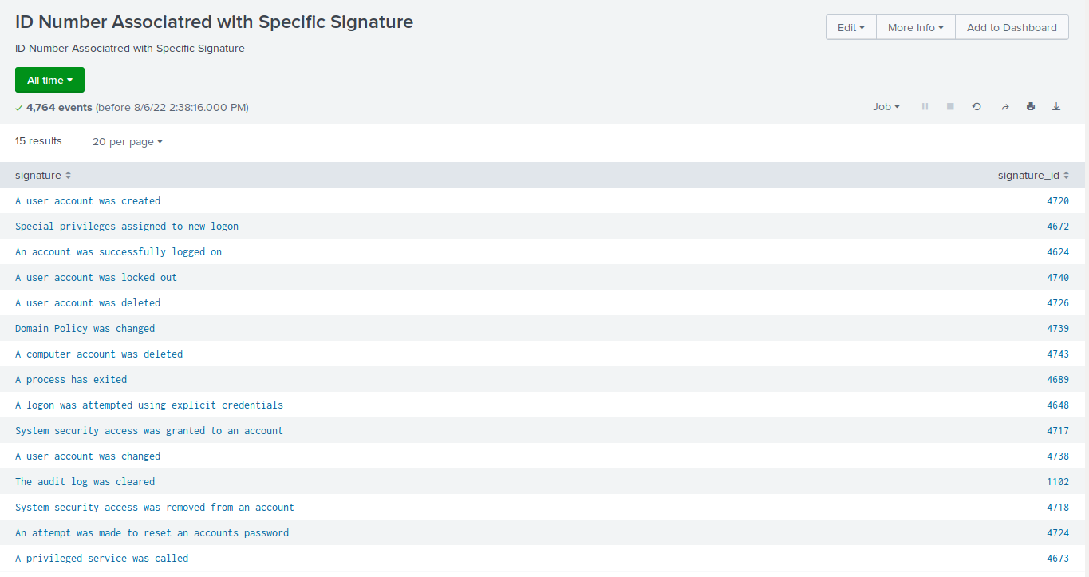
Images of Reports—Windows

Slide 13
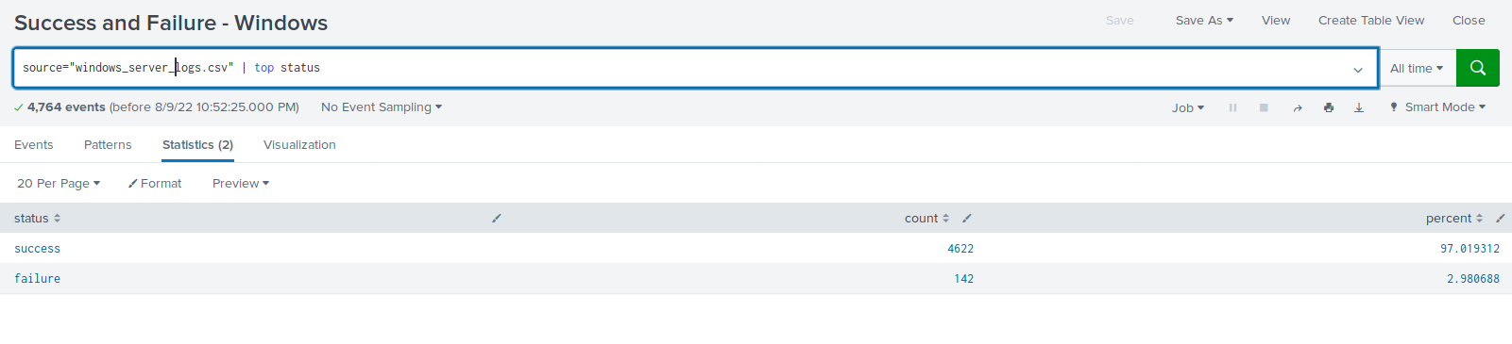
Images of Reports—Windows

Slide 14
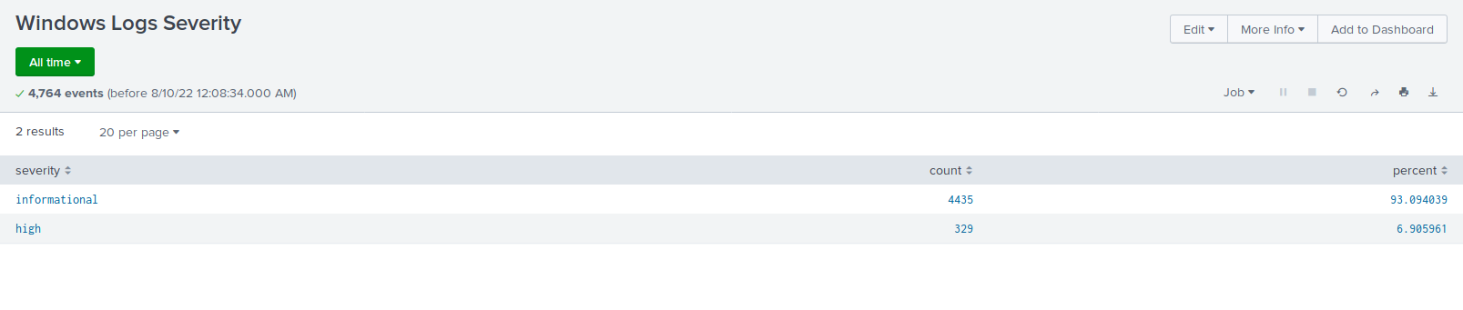
Images of Reports—Windows

Slide 15
Alerts—Windows
Designed the following alerts:
Alert Name | Alert Description | Alert Baseline | Alert Threshold
VSI of suspicious activity | Threshold of failed Windows Activity reach | 6 | 12
JUSTIFICATION: The average amount of failed Windows activity averaged around 6 to establish our baseline yet never got close to 12. Failures exceeding 12 would certainly indicate suspicious activity.

Slide 16
Alerts—Windows
Designed the following alerts:
Alert Name | Alert Description | Alert Baseline | Alert Threshold
VSI Account Successfully Logged on | Threshold of Successful Logged on by Account | 12 | 30
JUSTIFICATION: The average amount of failed Windows activity averaged around 12 to establish our baseline yet never got close to 30. Failures exceeding 30 would certainly indicate suspicious activity.

Slide 17
Alerts—Windows
Designed the following alerts:
Alert Name | Alert Description | Alert Baseline | Alert Threshold
VSI Deleted User Accounts | Threshold of Deleted User Accounts | 13 | 50
JUSTIFICATION: A baseline of 13 seemed on par with a “normal” hour. Exceeding 50 would raise suspicion levels and indicate a problem.

Slide 18
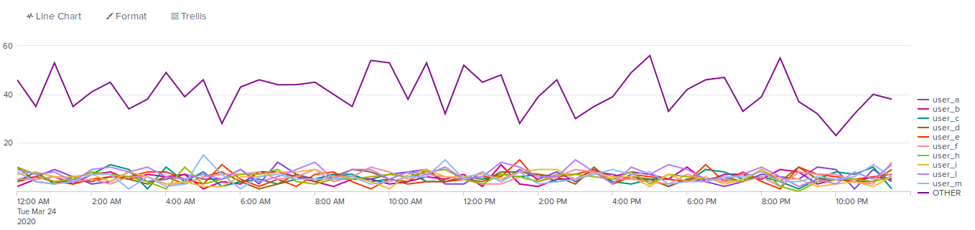

Dashboards—Windows

Slide 19
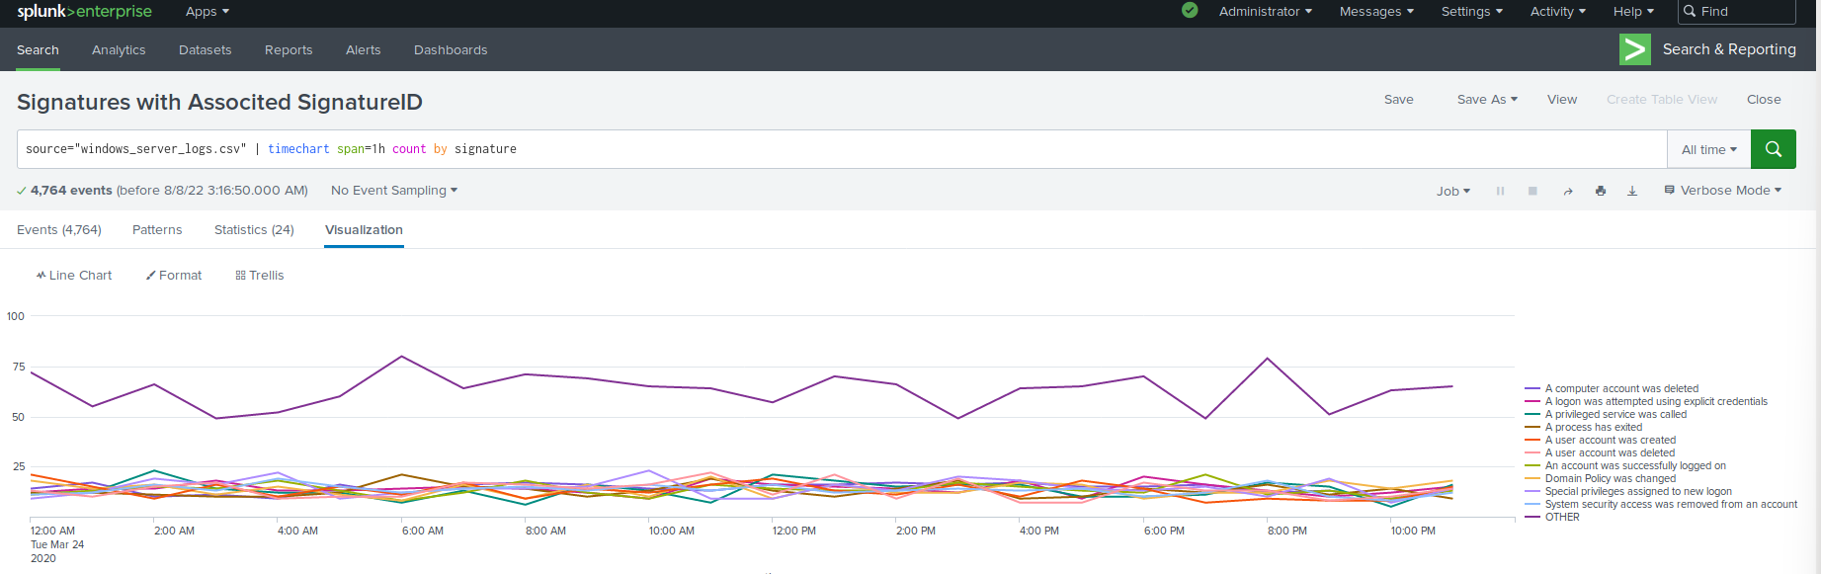
Dashboards—Windows

Slide 20
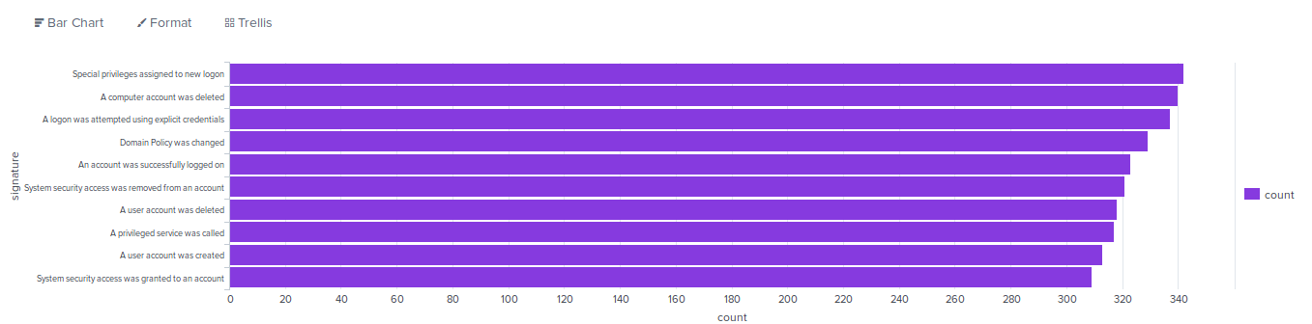
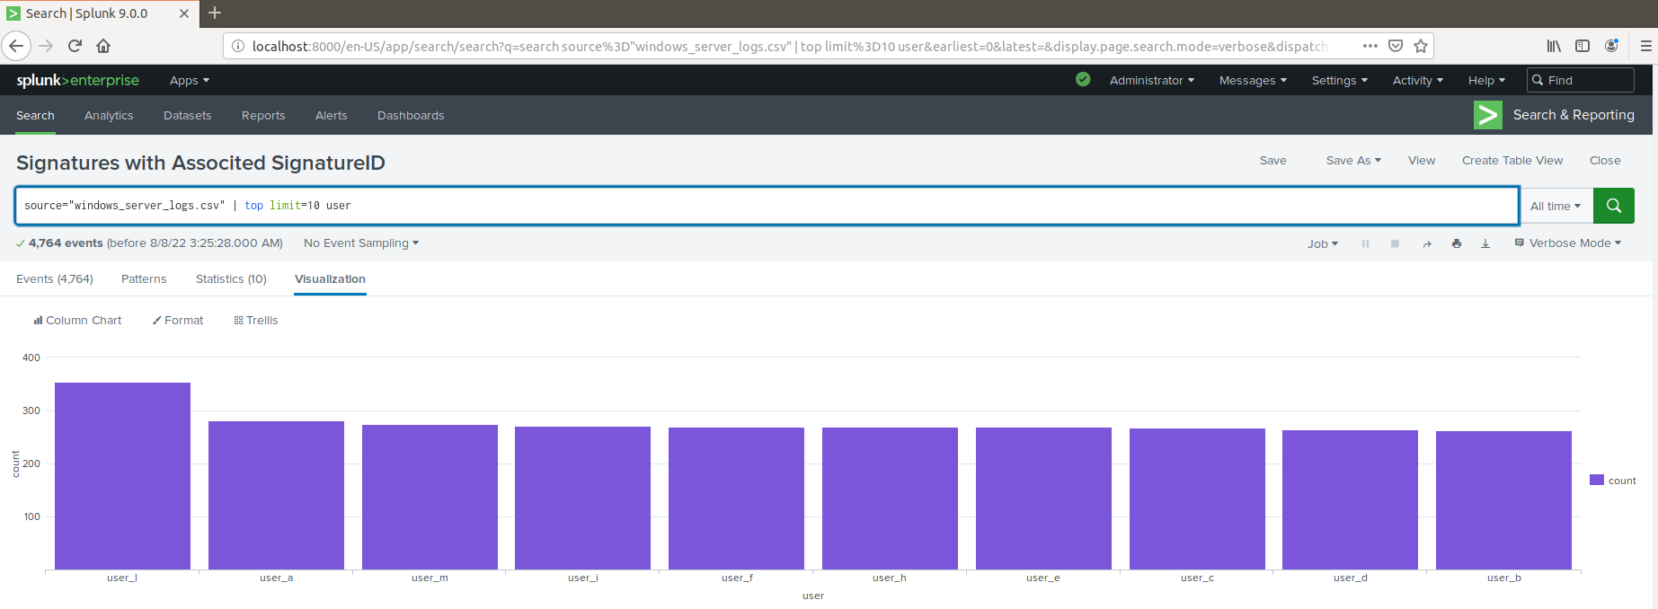
Dashboards—Windows

Slide 21
Apache Logs
‹#›

Slide 22
Reports—Apache
Designed the following reports:
Report Name | Report Description
HTTP Methods | A report will provide insight into the type of HTTP activity being requested against VSI's web server.
Top 10 Domains | A report that shows the top 10 domains that refer to VSI’s website
Count of HTTP Response Code | A report that shows the count of each HTTP response code.

Slide 23
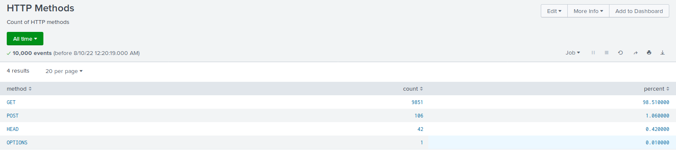
Images of Reports—Apache

Slide 24
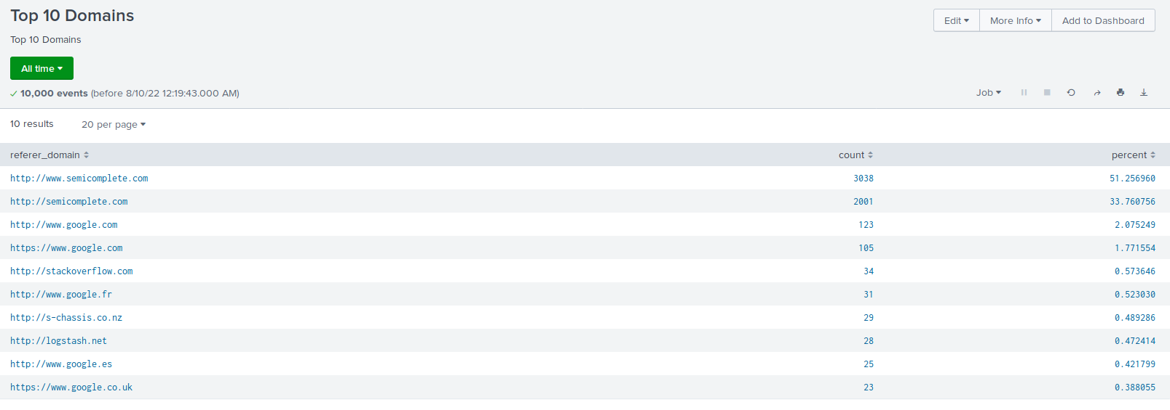
Images of Reports—Apache

Slide 25
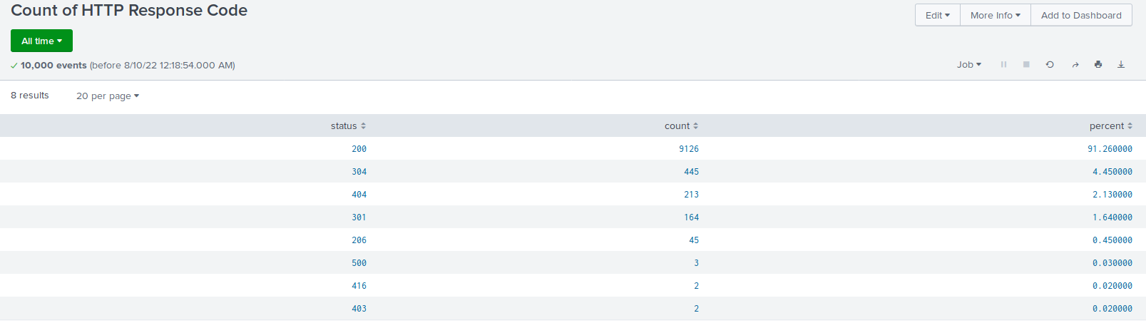
Images of Reports—Apache

Slide 26
Alerts—Apache
Designed the following alerts:
Alert Name | Alert Description | Alert Baseline | Alert Threshold
VSI non-USA Activity | Alert if the hourly activity from any country besides the United States exceeds the threshold. | 120 | 170
JUSTIFICATION: 120 events in a hour seemed standard in the logs, yet exceeding 170 seemed unlikely on a normal day. Seeing any number of events greater than the threshold would indicate issues.

Slide 27
Alerts—Apache
Designed the following alerts:
Alert Name | Alert Description | Alert Baseline | Alert Threshold
VSI HTTP POST Count | Alert if the hourly count of the HTTP POST method exceeds the threshold. | 3 | 12
JUSTIFICATION: Most events per hour hovered between 1 and 4 and never surpassed 7. A threshold of 12 seemed like a number that would be out of reach of “normal” hourly events but small enough to catch malicious activity.

Slide 28
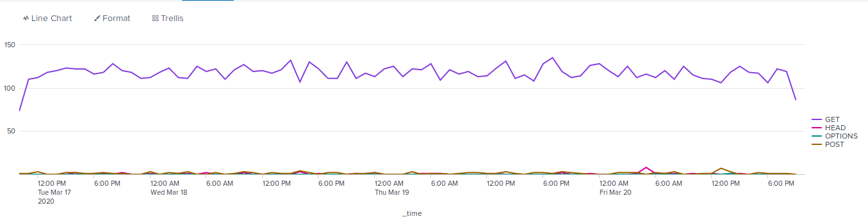
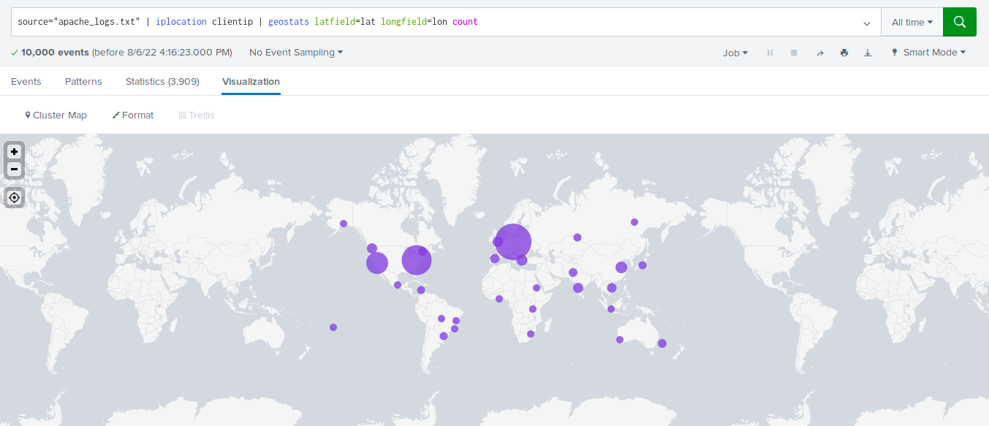
Dashboards—Apache

Slide 29
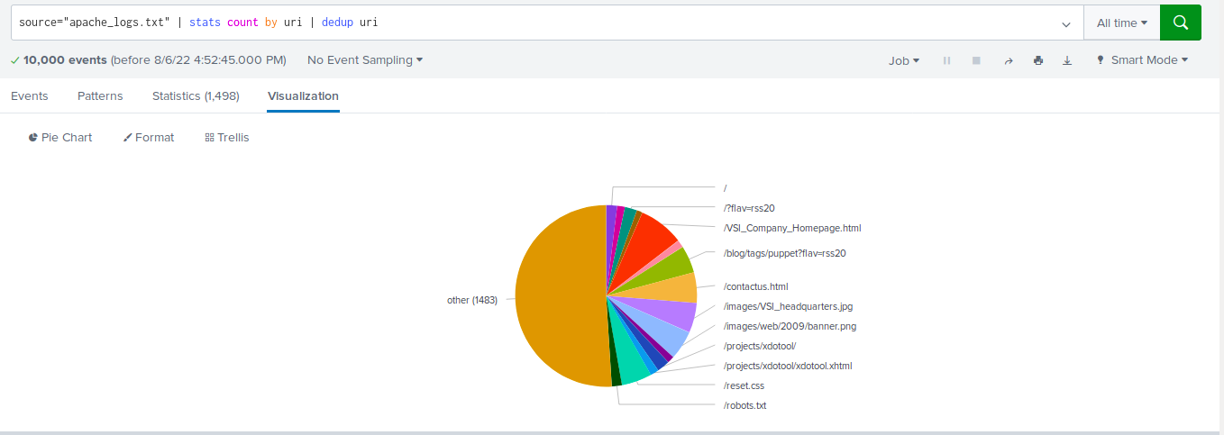
Dashboards—Apache

Slide 30
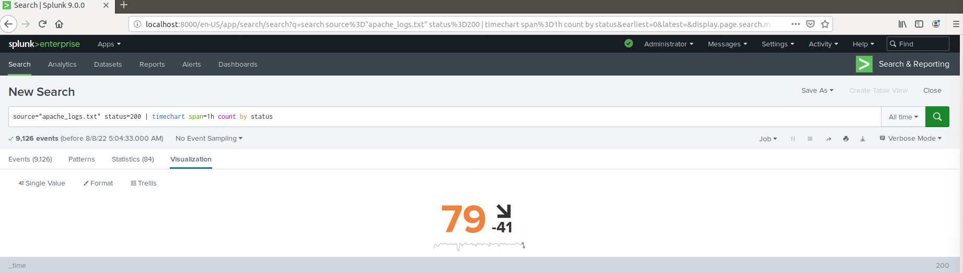
Dashboards—Apache

Slide 31
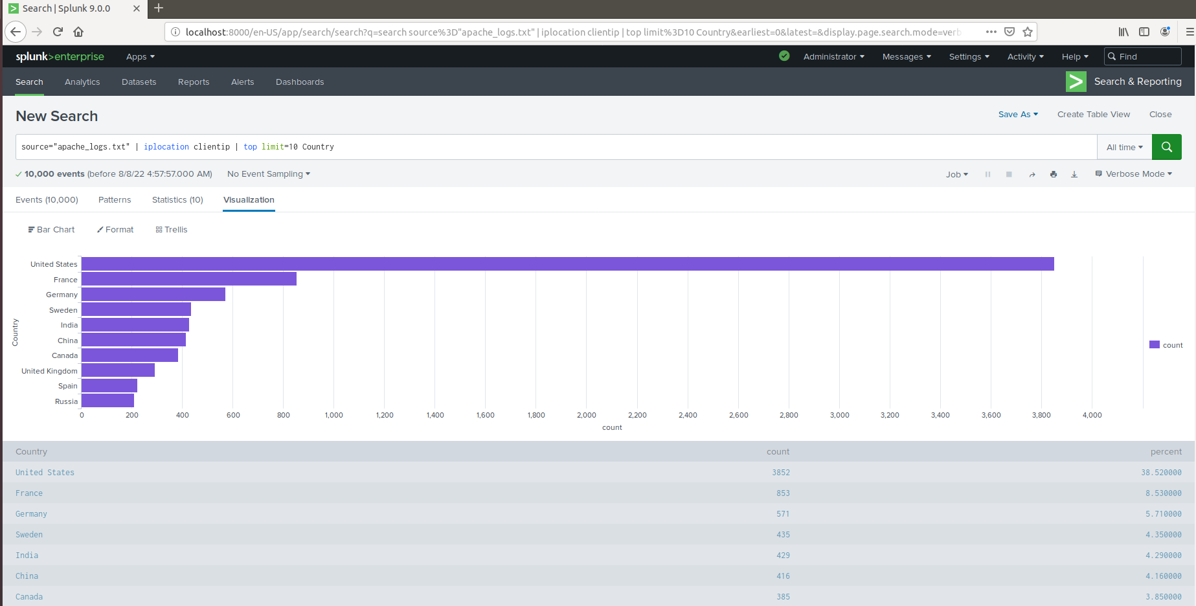
Dashboards—Apache

Slide 32
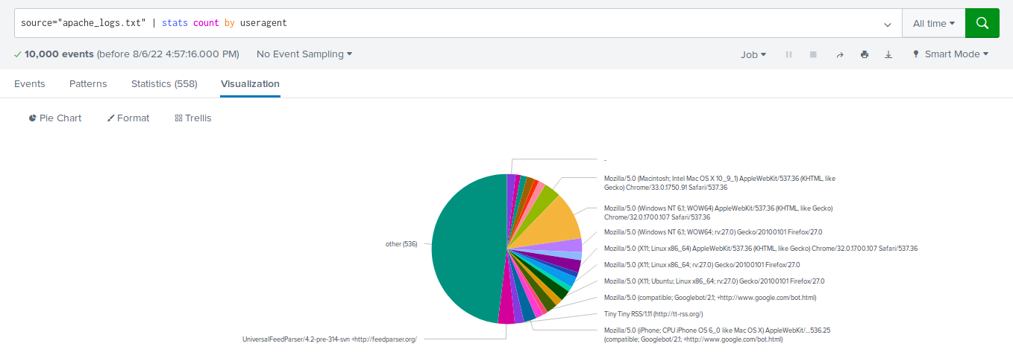
Dashboards—Apache

Slide 33
Attack Analysis
‹#›

Slide 34
Attack Summary—Windows
Summarize of findings from analyzing Windows attack logs.
-Windows attack system had more severity levels in the “high” category than almost 95% “informational” that was seen before the attack. Also noted more successes than failures after the attack. Alert analysis indicated suspicious volume of failed activity.
-Failed logins -35 events occurred 8am on 3/25/2020. Threshold was exceeded. No changes are recommended.
-Successful logins- suspicious volumes of successful logins detected
196 events detected in 1 hour;primary user logging in-user_J, occurred on 3/25/2020 at 11am.
Alert set exceeded threshold of 10 set.
A change in threshold is recommended from 10 to 25

Slide 35
Attack Summary—Windows
-Alert analysis indicated suspicious volume of failed activity.
Deleted account
-No suspicious volume of deleted accounts. Threshold was set to >25.
-Signature that stood out “A user account was locked out” and “An attempt was made to reset an accounts password”.
Start & Stop time for each signature“A user account…” - 1:40am to 2:40am
“An attempt…” - 9:10am to 11am
Peak count of different signatures
“A user account…” - 785
“An attempt…” - 397
Issue-Logs provided did not provide enough data for analysis.

Slide 36
Attack Summary—Windows
Summary of findings from dashboards: Analyzing the attack logs.
There was suspicious activity noted 2 users that stood out; User_A & User
Start & Stop time: User_A 1:40 am - 2:40 am | User_K 9:10 am - 11:00 am
Peak Count of different users: User_A 785 | User_K 397
There was suspicious activity with the signatures, specifically, “A user account was locked out” and “An attempt was made to reset an accounts password” as both had very high volumes of activity.
The first lasted from 1:40 am to 2:40 am and the second was from 9:10 am to 11 am.
“A user account…” peaked at a count of 785 and “An attempt…” peaked at 397.
Notes:
Note: All the graphs agreed with each other (bar and line) though the line graph was better for seeing times attacks occurred throughout the the day.

Slide 37
Attack Summary—Apache
Summarize your findings from your reports when analyzing the attack logs.
There was a significant increase in POST, HTTP methods.
We did not detect any suspicious activity in referrer domains.
It is possible our reports did not catch it. More analysis is needed.
The HTTP Response Codes report showed that “404” jumped from 2% to 15%.
Notes:
We might need to do more with detecting suspicious activity in referrer domains. Modifications to our report require further research.

Slide 38
Attack Summary—Apache
Summarize your findings from your alerts when analyzing the attack logs. Were the thresholds correct?
We detected a suspicious volume of international activity between 8pm and 9pm.
Our threshold was correct and our alert would have been triggered.
We detected a suspicious volume of HTTP POST activity between 8pm and 9pm on March 25th. It peaked at 1,296.
Our threshold was correct and our alert would have triggered.

Slide 39
Attack Summary—Apache
Summarize your findings from your dashboards when analyzing the attack logs.
Our Time Chart of HTTP methods revealed suspicious volumes of GET and POST methods.
The GET attack went from 5pm to 7pm and peaked with a count of 729.
The POST attack went from 7pm to 9pm and peaked with a count of 1,296.
Our Cluster Map revealed suspicious activity from a couple cities.
Kiev (439), Kharkiv (433), D.C. (714), and NYC(549) all had high volumes of activity.
Our URI Data flagged “/VSI_Account_logon.php” as having suspiciously high volume.

Slide 40
Summary and Future Mitigations
‹#›

Slide 41
Project 3 Summary
Overall findings from the attack:
Our overall finding found that on March 25th VSI had multiple attacks on there Windows and Apache servers. These attacks mainly consisted of Bruteforce Password spamming, from different regions and countries across the glob.
To protect VSI from future attacks, what future mitigations would you recommend?
Two-factor authentication, the first line of defense against Brute force attacks.
Lock users out after a certain number of login attempts to prevent future attacks.

